Slide 1

Software Engineering / Coding Practices
Java Full Stack Program

Slide 2
What is Software Engineering?
Software Engineering is an engineering branch related to the evolution of software product using well-defined scientific principles, techniques, and procedures. The result of software engineering is an effective and reliable software product.
The term software engineering is the product of two words, software, and engineering.
The software is a collection of integrated programs.
Software subsists of carefully-organized instructions and code written by developers on any of various particular computer languages.
Computer programs and related documentation such as requirements, design models and user manuals.
Java Full Stack Program

Slide 3
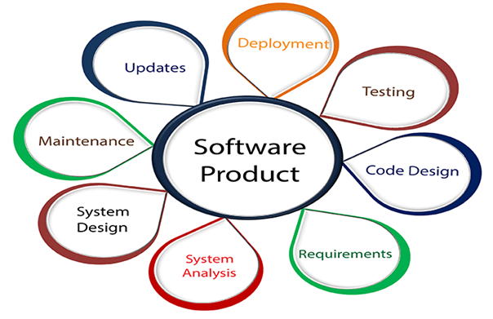
Engineering is the application of scientific and practical knowledge to invent, design, build, maintain, and improve frameworks, processes, etc.
Java Full Stack Program

Slide 4
Why is Software Engineering required?
Software Engineering is required due to the following reasons:
To manage Large software
For more Scalability
Cost Management
To manage the dynamic nature of software
For better quality Management
Need of Software Engineering
The necessity of software engineering appears because of a higher rate of progress in user requirements and the environment on which the program is working.
Java Full Stack Program

Slide 5
Need of Software Engineering
Huge Programming: It is simpler to manufacture a wall than to a house or building, similarly, as the measure of programming become extensive engineering has to step to give it a scientific process.
Adaptability: If the software procedure were not based on scientific and engineering ideas, it would be simpler to re-create new software than to scale an existing one.
Cost: As the hardware industry has demonstrated its skills and huge manufacturing has let down the cost of computer and electronic hardware. But the cost of programming remains high if the proper process is not adapted.
Dynamic Nature: The continually growing and adapting nature of programming hugely depends upon the environment in which the client works. If the quality of the software is continually changing, new upgrades need to be done in the existing one.
Java Full Stack Program

Slide 6
Characteristics of a good software engineer
The features that good software engineers should possess are as follows:
Exposure to systematic methods, i.e., familiarity with software engineering principles.
Good technical knowledge of the project range (Domain knowledge).
Good programming abilities.
Good communication skills. These skills comprise of oral, written, and interpersonal skills.
High motivation.
Ability to work in a team.
Sound knowledge of fundamentals of computer science.
Intelligence.
Java Full Stack Program

Slide 7
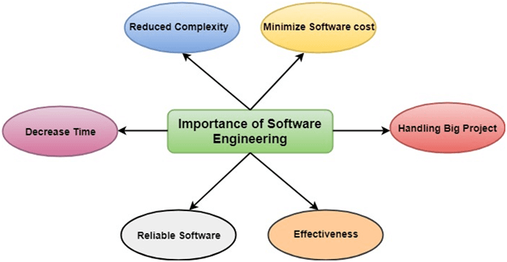
Importance of Software Engineering
Java Full Stack Program

Slide 8
The importance of Software engineering is as follows:
Reduces complexity: Big software is always complicated and challenging to progress. Software engineering has a great solution to reduce the complication of any project. Software engineering divides big problems into various small issues. And then start solving each small issue one by one. All these small problems are solved independently to each other.
To minimize software cost: Software needs a lot of hardwork and software engineers are highly paid experts. A lot of manpower is required to develop software with a large number of codes. But in software engineering, programmers project everything and decrease all those things that are not needed. In turn, the cost for software productions becomes less as compared to any software that does not use software engineering method.
Java Full Stack Program

Slide 9
To decrease time: Anything that is not made according to the project always wastes time. And if you are making great software, then you may need to run many codes to get the definitive running code. This is a very time-consuming procedure, and if it is not well handled, then this can take a lot of time. So if you are making your software according to the software engineering method, then it will decrease a lot of time.
Handling big projects: Big projects are not done in a couple of days, and they need lots of patience, planning, and management. And to invest six and seven months of any company, it requires heaps of planning, direction, testing, and maintenance. No one can say that he has given four months of a company to the task, and the project is still in its first stage. Because the company has provided many resources to the plan and it should be completed. So to handle a big project without any problem, the company has to go for a software engineering method.
Java Full Stack Program

Slide 10
Reliable software: Software should be secure, means if you have delivered the software, then it should work for at least its given time or subscription. And if any bugs come in the software, the company is responsible for solving all these bugs. Because in software engineering, testing and maintenance are given, so there is no worry of its reliability.
Effectiveness: Effectiveness comes if anything has made according to the standards. Software standards are the big target of companies to make it more effective. So Software becomes more effective in the act with the help of software engineering.
Java Full Stack Program

Slide 11
Software Processes
The term software specifies to the set of computer programs, procedures and associated documents (Flowcharts, manuals, etc.) that describe the program and how they are to be used.
A software process is the set of activities and associated outcome that produce a software product. Software engineers mostly carry out these activities. These are four key process activities, which are common to all software processes. These activities are:
Software specifications: The functionality of the software and constraints on its operation must be defined.
Software development: The software to meet the requirement must be produced.
Software validation: The software must be validated to ensure that it does what the customer wants.
Software evolution: The software must evolve to meet changing client needs.
Java Full Stack Program

Slide 12
The Software Process Model
A software process model is a specified definition of a software process, which is presented from a particular perspective. Models, by their nature, are a simplification, so a software process model is an abstraction of the actual process, which is being described. Process models may contain activities, which are part of the software process, software product, and the roles of people involved in software engineering. Some examples of the types of software process models that may be produced are:
A workflow model: This shows the series of activities in the process along with their inputs, outputs and dependencies. The activities in this model perform human actions.
Java Full Stack Program

Slide 13
A dataflow or activity model: This represents the process as a set of activities, each of which carries out some data transformations. It shows how the input to the process, such as a specification is converted to an output such as a design. The activities here may be at a lower level than activities in a workflow model. They may perform transformations carried out by people or by computers.
A role/action model: This means the roles of the people involved in the software process and the activities for which they are responsible.
Java Full Stack Program

Slide 14
The waterfall approach: This takes the above activities and produces them
as separate process phases such as requirements specification, software design, implementation, testing, and so on. After each stage is defined, it is "signed off" and development goes onto the following stage.
Evolutionary development: This method interleaves the activities of specification, development, and validation. An initial system is rapidly developed from a very abstract specification.
Formal transformation: This method is based on producing a formal mathematical system specification and transforming this specification, using mathematical methods to a program. These transformations are 'correctness preserving.' This means that you can be sure that the developed programs meet its specification.
System assembly from reusable components: This method assumes the parts of the system already exist. The system development process target on integrating these parts rather than developing them from scratch.
Java Full Stack Program

Slide 15
Software Crisis
Size: Software is becoming more expensive and more complex with the growing complexity and expectation out of software. For example, the code in the consumer product is doubling every couple of years.
Quality: Many software products have poor quality, i.e., the software products defects after putting into use due to ineffective testing technique. For example, Software testing typically finds 25 errors per 1000 lines of code.
Cost: Software development is costly i.e. in terms of time taken to develop and the money involved. For example, Development of the FAA's Advanced Automation System cost over $700 per lines of code.
Delayed Delivery: Serious schedule overruns are common. Very often the software takes longer than the estimated time to develop, which in turn leads to cost shooting up. For example, one in four large-scale development projects is never completed.
Java Full Stack Program

Slide 16
Software Development Life Cycle (SDLC)
A software life cycle model (also termed process model) is a pictorial and diagrammatic representation of the software life cycle. A life cycle model represents all the methods required to make a software product transit through its life cycle stages. It also captures the structure in which these methods are to be undertaken.
In other words, a life cycle model maps the various activities performed on a software product from its inception to retirement. Different life cycle models may plan the necessary development activities to phases in different ways. Thus, no element which life cycle model is followed, the essential activities are contained in all life cycle models though the action may be carried out in distinct orders in different life cycle models. During any life cycle stage, more than one activity may also be carried out.
Java Full Stack Program

Slide 17
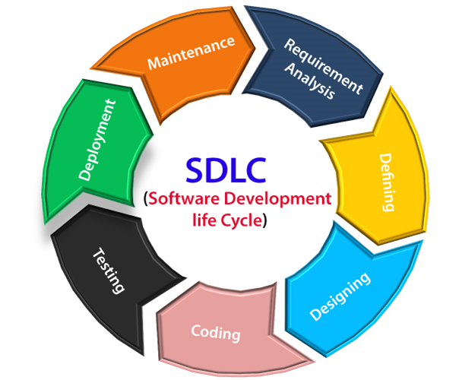
SDLC Cycle
SDLC Cycle represents the process of developing software. SDLC framework includes the following steps:
Java Full Stack Program

Slide 18
The stages of SDLC are as follows:
Stage1: Planning and requirement analysis
Requirement Analysis is the most important and necessary stage in SDLC.
The senior members of the team perform it with inputs from all the stakeholders and domain experts or SMEs in the industry.
Planning for the quality assurance requirements and identifications of the risks associated with the projects is also done at this stage.
Java Full Stack Program

Slide 19
Stage2: Defining Requirements
Once the requirement analysis is done, the next stage is to certainly represent and document the software requirements and get them accepted from the project stakeholders.
This is accomplished through "SRS"- Software Requirement Specification document which contains all the product requirements to be constructed and developed during the project life cycle.
Stage3: Designing the Software
The next phase is about to bring down all the knowledge of requirements, analysis, and design of the software project. This phase is the product of the last two, like inputs from the customer and requirement gathering.
Java Full Stack Program

Slide 20
Stage4: Developing the project
In this phase of SDLC, the actual development begins, and the programming is built. The implementation of design begins concerning writing code. Developers have to follow the coding guidelines described by their management and programming tools like compilers, interpreters, debuggers, etc. are used to develop and implement the code.
Stage5: Testing
After the code is generated, it is tested against the requirements to make sure that the products are solving the needs addressed and gathered during the requirements stage.
During this stage, unit testing, integration testing, system testing, acceptance testing are done.
Java Full Stack Program

Slide 21
Stage6: Deployment
Once the software is certified, and no bugs or errors are stated, then it is deployed.
Then based on the assessment, the software may be released as it is or with suggested enhancement in the object segment.
After the software is deployed, then its maintenance begins.
Stage7: Maintenance
Once when the client starts using the developed systems, then the real issues come up and requirements to be solved from time to time.
This procedure where the care is taken for the developed product is known as maintenance.
Java Full Stack Program

Slide 22
Coding Practices
What Does Coding Really Mean?
Coding is the practice of building websites and apps by writing out instructions in a programming language. It governs how data is collected, how sites appear to the user, and every aspect of how you engage with the web.
The definition of "coding" means inputting commands in a language that computers can understand, to build websites, apps and software.
Simply put, computer coding is the process of using a programming language to deliver instructions to a computer. The code tells the machine what tasks to perform and how to perform them. These detailed instructions are written in multiple lines of code, and a document full of code is called a script.
Java Full Stack Program

Slide 23
Skills You Need to Become A Coder
A great coder relies on both hard and soft skills. Here are some of the most important skills you should think about developing over time.
Hard Skills:
Problem solving: if you enjoy working through puzzles, you’ll probably excel as a coder.
Logic: every coding languages follows a set of rules, so you’ll need to think through challenges and predict the outcome.
Mathematical thinking: while math isn’t often used in coding itself, those who enjoy math tend to relish the challenge of learning a coding language.
Java Full Stack Program

Slide 24
Soft Skills:
Creativity: many coding problems have multiple solutions, so you’ll need to be creative and come up with the most efficient one.
Collaboration: many coders work on a team with other software engineers.
Communication: you’ll have to share technical information in a way that’s easy for non-coders to understand.
Attention to detail: you’ll need to focus on your work and catch bugs before they cause major problems.
Java Full Stack Program

Slide 25
How Coding Works
To understand how coding works, we first need to understand what transistors are. The human brain has billions of cells called neurons that allow us to store memories and have conscious thought.
Similarly, computers contain billions of transistors, whose function is the same as that of neurons. A computer only understands two types of data: on and off. Transistors are simple on/off switches. The 0s and 1s in binary code instruct these switches to turn on or off.
Modern day computers contain millions, even billions of transistors. It would be impossible to type billions of 1s and 0s to set instructions.
To solve this problem, computer coding languages were developed. Using these languages, coders can translate important commands to binary code.
Java Full Stack Program

Slide 26
what is the right way to do coding ?
Write clear and concise code: Make your code easy to read and understand by others. Use descriptive variable and function names, and avoid using unnecessary or ambiguous syntax.
Follow coding standards and best practices: Many programming languages have established coding standards and best practices that can help ensure consistency and maintainability. Follow these standards and practices whenever possible.
Plan and organize your code: Before you start writing code, plan out your project and break it down into smaller, manageable tasks. Use a consistent file and folder structure, and organize your code logically to make it easier to navigate.
Java Full Stack Program

Slide 27
Test and debug your code: Test your code thoroughly to identify and fix any errors or bugs.
Use automated testing tools and debuggers to speed up the process.
Continuously learn and improve: Keep up-to-date with new coding techniques and technologies, and continuously improve your skills. Seek feedback and advice from others, and be open to constructive criticism.
Ultimately, the most important thing is to find a coding style and approach that works for you and your project, and to continuously improve and adapt as needed.
Java Full Stack Program

Slide 28
THANK YOU
Java Full Stack Program

